Slide 1

Reconocimiento de Patrones
Domingo Mery
Departamento de Ciencia de la Computación
Escuela de Ingeniería
Universidad Católica de Chile
Texturas de Haralick
[ Capítulo 2 ]

Slide 2
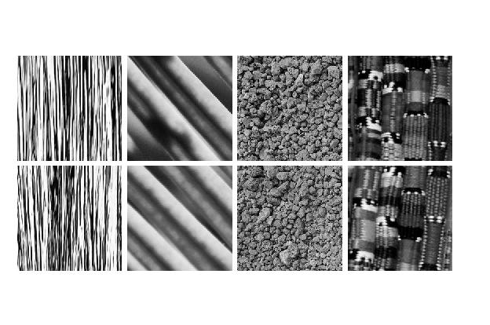
Different Textures ➔
Same Textures ➔

Slide 3
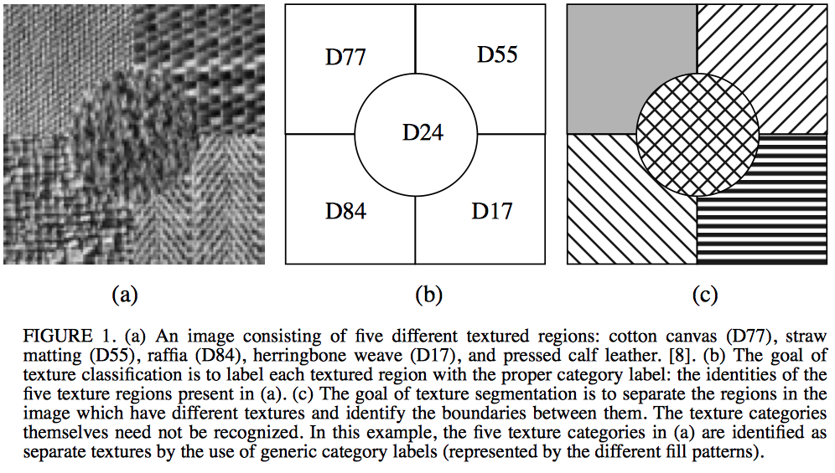
What are texture images?
The Handbook of Pattern Recognition and Computer Vision (2nd Edition), by C. H. Chen, L. F. Pau, P. S. P. Wang (eds.), pp. 207-248, World Scientific Publishing Co., 1998.

Slide 4
Co-occurrence matrices
They measure how is the distribution of co-occurring of pairs of pixels in an image.
Haralick, R.M., K. Shanmugan, and I. Dinstein (1973): Textural Features for Image Classification, IEEE Transactions on Systems, Man, and Cybernetics, SMC-3:610-621.

Slide 5
Co-occurrence matrices
They measure how is the distribution of co-occurring of pairs of pixels in an image.
Example:
Given an imagen I, the co-ccurrence matrix P₁₀ is computed as follows:
1 0 1 2
1 1 0 0
0 2 1 0
0 2 0 2
I =

Slide 6
Co-occurrence matrices
They measure how is the distribution of co-occurring of pairs of pixels in an image.
Example:
Given an imagen I, the co-ccurrence matrix P₁₀ is computed as follows:
10 indicates 1 ⬇ and 0 ➔:
1 0 1 2
1 1 0 0
0 2 1 0
0 2 0 2
I =
first pixel
second pixel
v
second pixel is located 1 pixel down,
and 0 pixels to the right of the first pixel.

Slide 7
Co-occurrence matrices
They measure how is the distribution of co-occurring of pairs of pixels in an image.
Example:
Given an imagen I, the co-ccurrence matrix P₁₀ is computed as follows:
10 indicates 1 ⬇ and 0 ➔:
1 0 1 2
1 1 0 0
0 2 1 0
0 2 0 2
I =
first pixel
second pixel
v
second pixel is located 1 pixel down,
and 0 pixels to the right of the first pixel.
For direction 10, there are 12 possible pairs
pixels that can be analized.

Slide 8
Co-occurrence matrices
They measure how is the distribution of co-occurring of pairs of pixels in an image.
Example:
Given an imagen I, the co-ccurrence matrix P₁₀ is computed as follows:
value of the
second pixel
1 0 1 2
1 1 0 0
0 2 1 0
0 2 0 2
0 1 2
0 ? ? ?
1 ? ? ?
2 ? ? ?
I =
P₁₀ =
value of the
first pixel

Slide 9
Co-occurrence matrices
They measure how is the distribution of co-occurring of pairs of pixels in an image.
Example:
Given an imagen I, the co-ccurrence matrix P₁₀ is computed as follows:
value of the
second pixel
1 0 1 2
1 1 0 0
0 2 1 0
0 2 0 2
0 1 2
0 ? ? ?
1 ? ? ?
2 ? ? ?
I =
1
12
P₁₀ =
value of the
first pixel
normalization

Slide 10
Co-occurrence matrices
They measure how is the distribution of co-occurring of pairs of pixels in an image.
Example:
Given an imagen I, the co-ccurrence matrix P₁₀ is computed as follows:
value of the
second pixel
1 0 1 2
1 1 0 0
0 2 1 0
0 2 0 2
0 1 2
0 ? ? ?
1 ? ? ?
2 ? ? ?
I =
1
12
P₁₀ =
value of the
first pixel
¿how many there are in image I ?

Slide 11
Co-occurrence matrices
They measure how is the distribution of co-occurring of pairs of pixels in an image.
Example:
Given an imagen I, the co-ccurrence matrix P₁₀ is computed as follows:
value of the
second pixel
1 0 1 2
1 1 0 0
0 2 1 0
0 2 0 2
0 1 2
0 ? ? ?
1 ? ? ?
2 ? ? ?
I =
1
12
P₁₀ =
value of the
first pixel
0
0
¿how many there are in image I ?

Slide 12
Co-occurrence matrices
They measure how is the distribution of co-occurring of pairs of pixels in an image.
Example:
Given an imagen I, the co-ccurrence matrix P₁₀ is computed as follows:
value of the
second pixel
1 0 1 2
1 1 0 0
0 2 1 0
0 2 0 2
0 1 2
0 2 ? ?
1 ? ? ?
2 ? ? ?
I =
1
12
P₁₀ =
value of the
first pixel
0
0
¿how many there are in image I ?

Slide 13
Co-occurrence matrices
They measure how is the distribution of co-occurring of pairs of pixels in an image.
Example:
Given an imagen I, the co-ccurrence matrix P₁₀ is computed as follows:
value of the
second pixel
1 0 1 2
1 1 0 0
0 2 1 0
0 2 0 2
0 1 2
0 2 ? ?
1 ? ? ?
2 ? ? ?
I =
1
12
P₁₀ =
value of the
first pixel
0
1
¿how many there are in image I ?

Slide 14
Co-occurrence matrices
They measure how is the distribution of co-occurring of pairs of pixels in an image.
Example:
Given an imagen I, the co-ccurrence matrix P₁₀ is computed as follows:
value of the
second pixel
1 0 1 2
1 1 0 0
0 2 1 0
0 2 0 2
0 1 2
0 2 2 ?
1 ? ? ?
2 ? ? ?
I =
1
12
P₁₀ =
value of the
first pixel
0
1
¿how many there are in image I ?

Slide 15
Co-occurrence matrices
They measure how is the distribution of co-occurring of pairs of pixels in an image.
Example:
Given an imagen I, the co-ccurrence matrix P₁₀ is computed as follows:
value of the
second pixel
1 0 1 2
1 1 0 0
0 2 1 0
0 2 0 2
0 1 2
0 2 2 1
1 ? ? ?
2 ? ? ?
I =
1
12
P₁₀ =
value of the
first pixel
0
2
¿how many there are in image I ?

Slide 16
Co-occurrence matrices
They measure how is the distribution of co-occurring of pairs of pixels in an image.
Example:
Given an imagen I, the co-ccurrence matrix P₁₀ is computed as follows:
value of the
second pixel
1 0 1 2
1 1 0 0
0 2 1 0
0 2 0 2
0 1 2
0 2 2 1
1 3 ? ?
2 ? ? ?
I =
1
12
P₁₀ =
value of the
first pixel
1
0
¿how many there are in image I ?

Slide 17
Co-occurrence matrices
They measure how is the distribution of co-occurring of pairs of pixels in an image.
Example:
Given an imagen I, the co-ccurrence matrix P₁₀ is computed as follows:
value of the
second pixel
1 0 1 2
1 1 0 0
0 2 1 0
0 2 0 2
0 1 2
0 2 2 1
1 3 1 ?
2 ? ? ?
I =
1
12
P₁₀ =
value of the
first pixel
1
1
¿how many there are in image I ?

Slide 18
Co-occurrence matrices
They measure how is the distribution of co-occurring of pairs of pixels in an image.
Example:
Given an imagen I, the co-ccurrence matrix P₁₀ is computed as follows:
value of the
second pixel
1 0 1 2
1 1 0 0
0 2 1 0
0 2 0 2
0 1 2
0 2 2 1
1 3 1 1
2 ? ? ?
I =
1
12
P₁₀ =
value of the
first pixel
1
2
¿how many there are in image I ?

Slide 19
Co-occurrence matrices
They measure how is the distribution of co-occurring of pairs of pixels in an image.
Example:
Given an imagen I, the co-ccurrence matrix P₁₀ is computed as follows:
value of the
second pixel
1 0 1 2
1 1 0 0
0 2 1 0
0 2 0 2
0 1 2
0 2 2 1
1 3 1 1
2 1 ? ?
I =
1
12
P₁₀ =
value of the
first pixel
2
0
¿how many there are in image I ?

Slide 20
Co-occurrence matrices
They measure how is the distribution of co-occurring of pairs of pixels in an image.
Example:
Given an imagen I, the co-ccurrence matrix P₁₀ is computed as follows:
value of the
second pixel
1 0 1 2
1 1 0 0
0 2 1 0
0 2 0 2
0 1 2
0 2 2 1
1 3 1 1
2 1 0 ?
I =
1
12
P₁₀ =
value of the
first pixel
2
1
¿how many there are in image I ?

Slide 21
Co-occurrence matrices
They measure how is the distribution of co-occurring of pairs of pixels in an image.
Example:
Given an imagen I, the co-ccurrence matrix P₁₀ is computed as follows:
value of the
second pixel
1 0 1 2
1 1 0 0
0 2 1 0
0 2 0 2
0 1 2
0 2 2 1
1 3 1 1
2 1 0 1
I =
1
12
P₁₀ =
value of the
first pixel
2
2
¿how many there are in image I ?

Slide 22
Co-occurrence matrices
They measure how is the distribution of co-occurring of pairs of pixels in an image.
Example:
Given an imagen I, the co-ccurrence matrix P₁₀ is:
1 0 1 2
1 1 0 0
0 2 1 0
0 2 0 2
0 1 2
0 2 2 1
1 3 1 1
2 1 0 1
I =
1
12
P₁₀ =

Slide 23
Co-occurrence matrices
They measure how is the distribution of co-occurring of pairs of pixels in an image.
Example:
Given an imagen I, the co-ccurrence matrix P₁₁ is:
1 0 1 2
1 1 0 0
0 2 1 0
0 2 0 2
? ? ?
? ? ?
? ? ?
I =
1
?
P₁₁ =
v

Slide 24
Co-occurrence matrices
They measure how is the distribution of co-occurring of pairs of pixels in an image.
Example:
Given an imagen I, the co-ccurrence matrix P₁₁ is:
1 0 1 2
1 1 0 0
0 2 1 0
0 2 0 2
2 0 1
1 2 2
1 0 0
I =
1
9
P₁₁ =
v

Slide 25
Definition of the Co-ocurrence Matrix
Vector v
l
v
k

Slide 26
What happens if
the diagonal of the co-occurrence matrix is high ?
That means, that in the selected direction the pixel values do not change significantly.

Slide 27
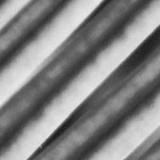
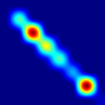
I
In this direction the pixel values do not change significantly.
v
P_{v}

Slide 28
What happens if
the diagonal of the co-occurrence matrix is low?
That means, that in the selected direction the pixel values do change significantly.

Slide 29
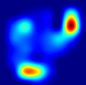
I
In this direction the pixel values do change significantly from low to high and from high to low.
v
P_{v}

Slide 30
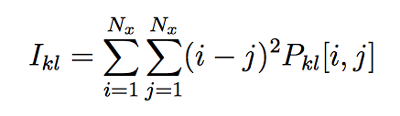

(i-j)²
Contrast
j
i
i
j

Slide 31
I
In this direction the pixel values do not change significantly.
v
(i-j)²
i
j
P_{v} (i - j)²
Contrast
= Σ
x
= low

Slide 32
I
In this direction the pixel values do change significantly from low to high and from high to low.
v
(i-j)²
i
j
P_{v} (i - j)²
Contrast
= Σ
x
= high

Slide 33
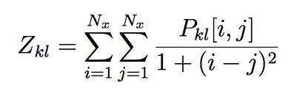
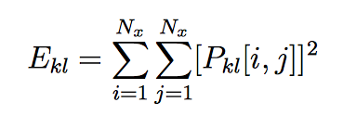
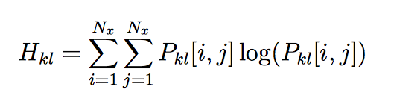
Features based on Co-occurrence Matrix
Contrast
Moment of
inverse difference
Energy
Entropy

Slide 34
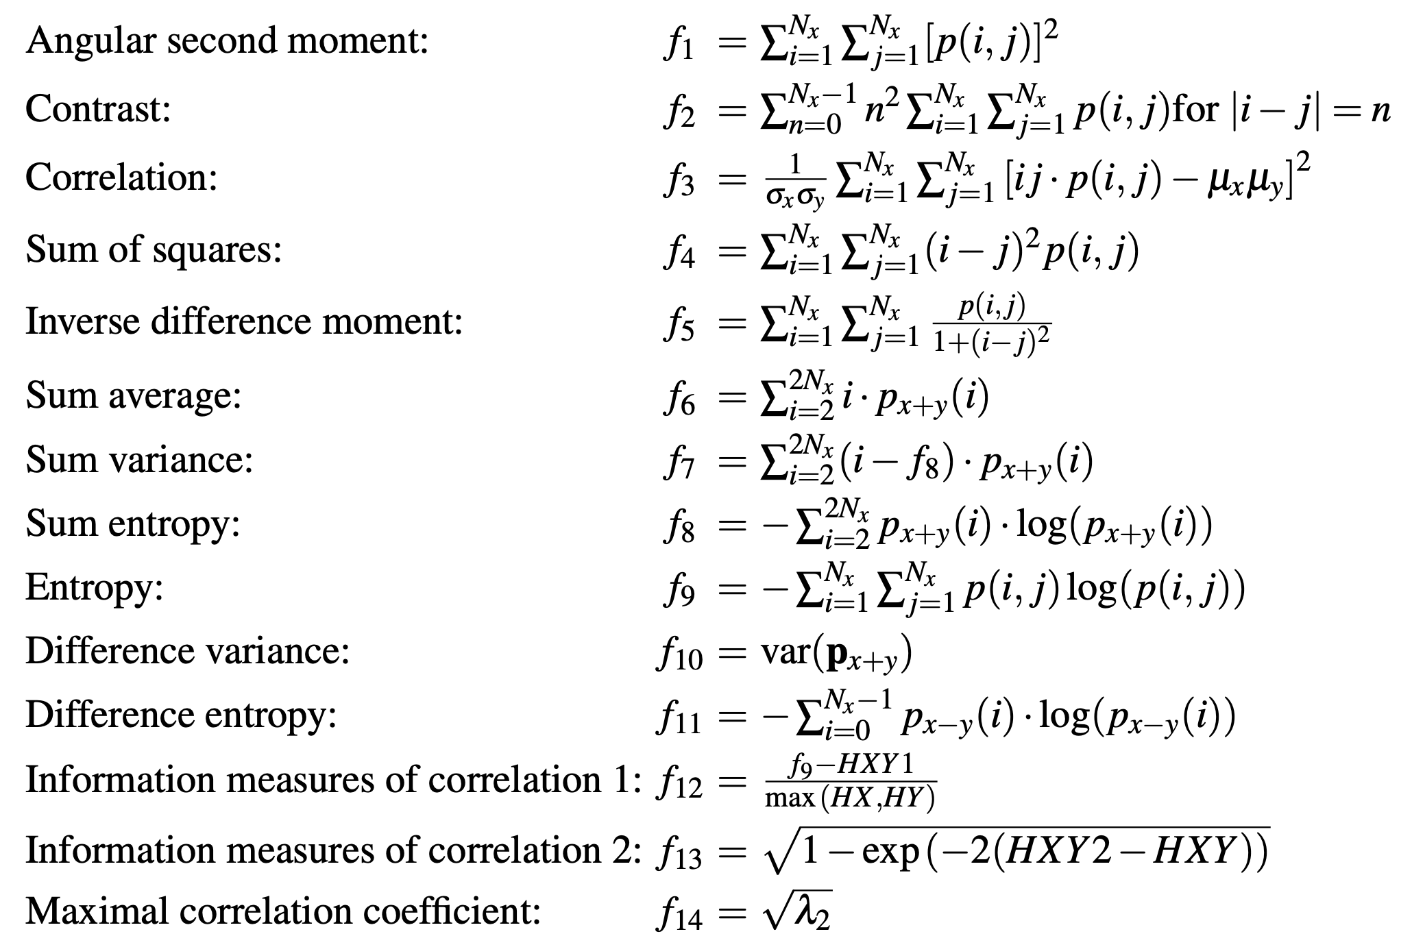
Features based on Co-occurrence Matrix

Slide 35
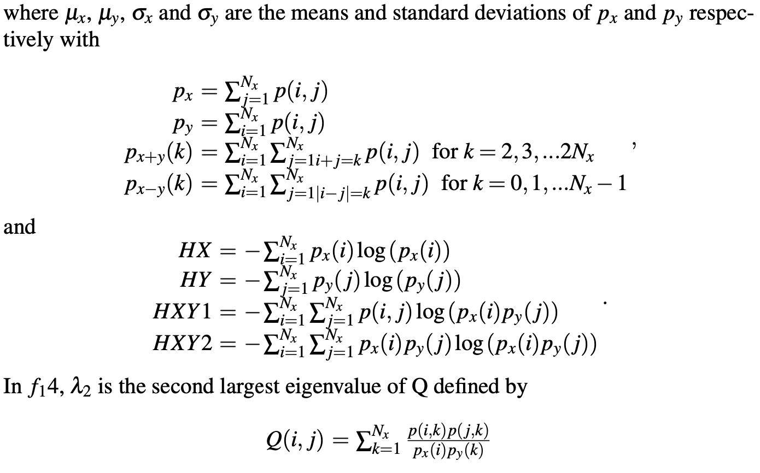

Slide 36
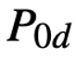
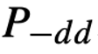
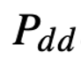
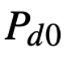
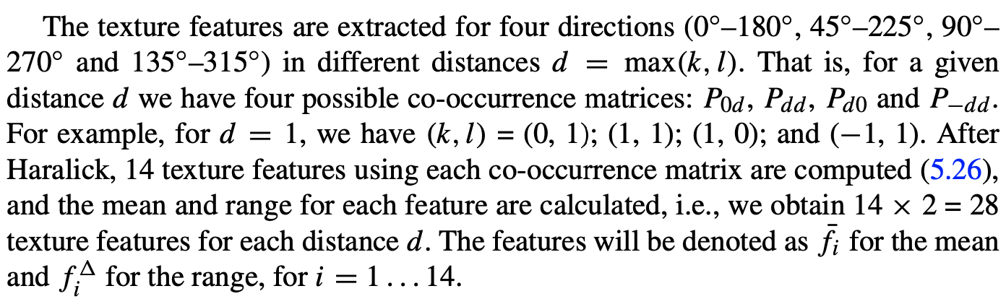
For a given ‘d’ in pixels,
we extract 4 co-occurrence matrices:
mean
(14 features)
14 features each
range (max-min)
(14 features)

Slide 37
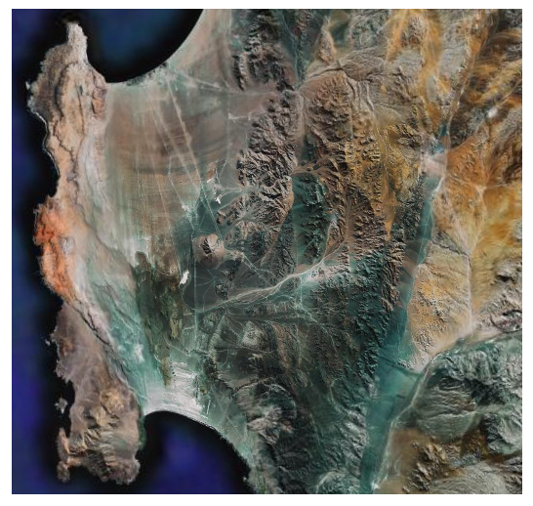
Example
Detection of
mountains and desert areas

Slide 38
Original

Slide 39
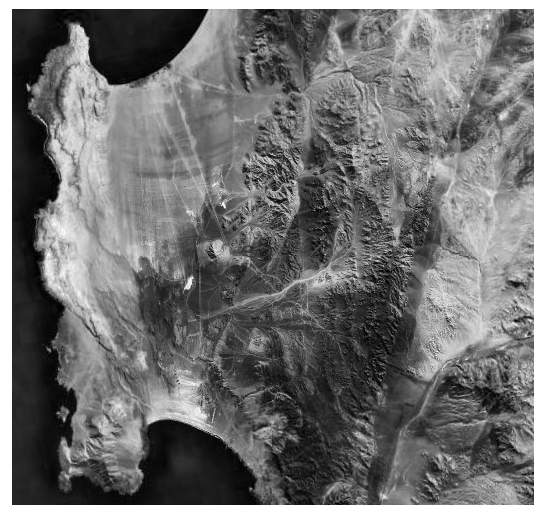
Red
channel

Slide 40
Red
channel
Extraction of
Haralick
Features

Slide 41
Red
channel

Slide 42
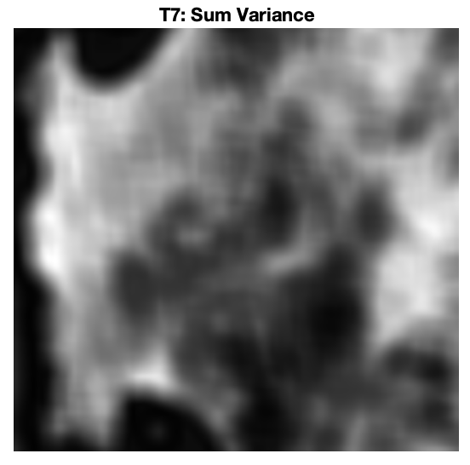
Sum
Variance

Slide 43
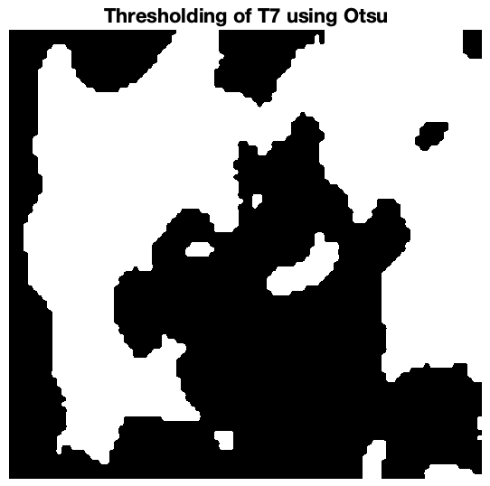
Sum
Variance
> Threshold

Slide 44
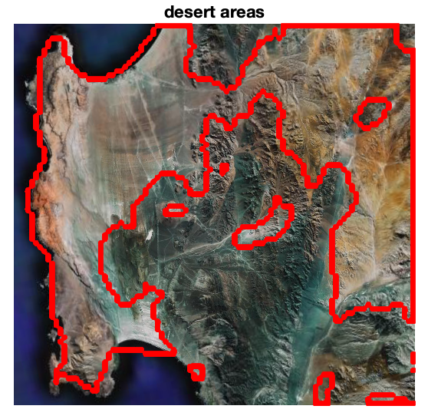
Sum
Variance
> Threshold

Slide 45
Sum
Variance
> Threshold
= desert
areas

Slide 47
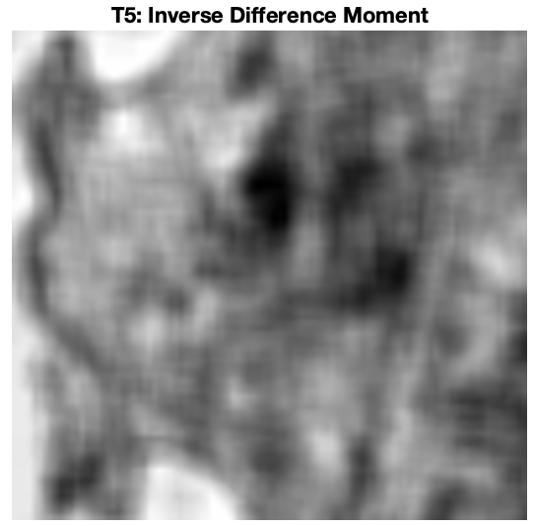
Inverse
Moment
Difference

Slide 48
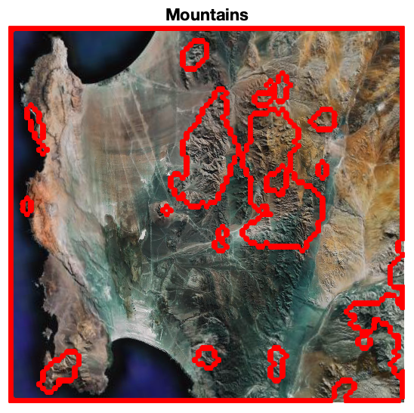
Inverse
Moment
Difference
< Threshold
= Mountains

Slide 49
